Slide 1
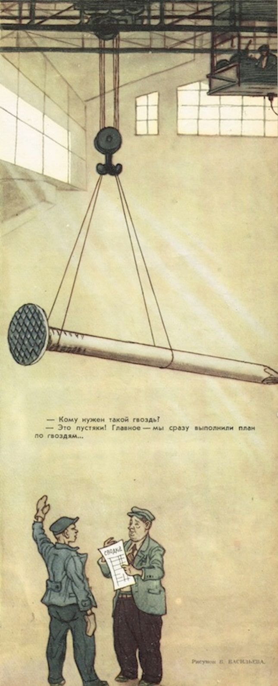
“Why Would Anyone Do That?”
Professor Judy Thornton of the University of Washington reports that when she was a student in Moscow, “…the small, blue metal lamp on my dormitory desk was so heavy it took two people to lift it. The lamp base had been filled with lead.…” The problem of grossly heavy products was not limited to the lamp industry, however. Professor Thornton tells of a cartoon that appeared in Krokodil, a popular weekly magazine, in which the entire staff of a plant is shown carrying a single giant nail out of the factory.

Slide 2
“Why Would Anyone Do That?”
CLUE: Both factories mentioned—the lamp factory and the nail factory—faced quotas and devised strategies to meet and exceed their quotas. Being paid depended on meeting quotas; bonuses were given for exceeding them.
QUESTIONS:
On what basis do you think the lamp factory quota was set?
If the quota were based on the number of lamps, what do you think would happen, based on incentives?

Slide 3
“Why Would Anyone Do That?”
Definition of incentives? (How are prices incentives?)
Soviet Union: no price incentives (firms not allowed profits)
ACTIVITY:
Get in groups of 3-5.
Groups: elect a discussion leader, recorder (to write notes), and a question asker who asks these two questions when needed: (a) Have we identified the incentives?, and (b) How is this behavior the same/different from behavior based on mar-ket economy incentives?
Hand out Scenarios 2 & 3. (DON’T LOOK AT THE BACK YET!)

Slide 4

“Why Would Anyone Do That?”
Scenario 2 class discussion
Groups: Discuss Scenario 3!
Scenario 3 class discussion
When price signals are missing, how does it affect what should be produced, and how much should be produced?
Quotas as incentives, instead of prices, result in what?
Why didn’t workers produce good/useful nails, and deep/effective oil drilling?
How do incentives confirm the Bible’s teaching, and also what writers/thinkers like Adam Smith and Frederic Bastiat say? Write a brief, 2-3 sentence explanation and be prepared to share it with the class.

